Slide 1

Polar Codes
Using MATLAB

Slide 2


Content
Intro To Polar Codes
Polarization Transformation Encoder
Successive Cancellation (SC) Decoder
The MATLAB implementation Code
MATLAB Results

Slide 3

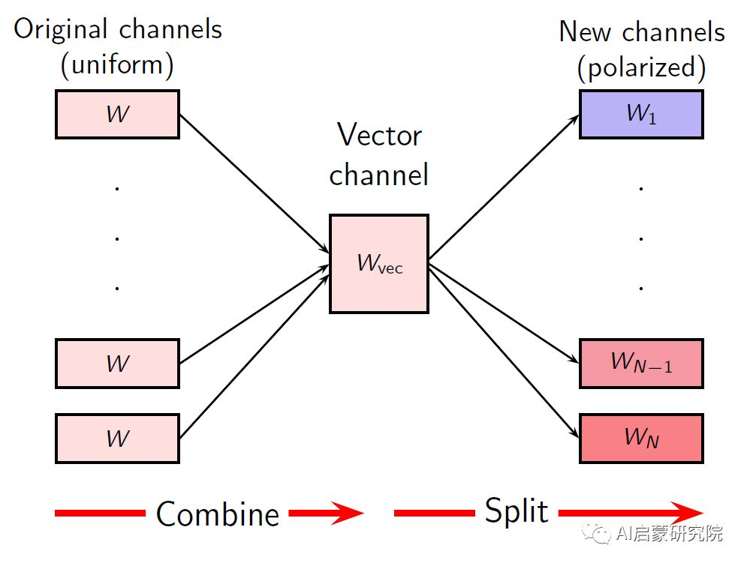
Intro To Polar Codes
Polar codes break the wheel somewhat in the field of channel coding.
Polar codes operate on blocks of symbols/bits and are therefore technically members of the block code family.
The transformation involves two key operations called channel combining and channel splitting.
The real magic in polar codes lies in the clever bit manipulations and mappings to the channels at the encoder to convert a block of bits into a polarized bit stream at the receiver.
That is a received bit and its associated channel ends up being either a “good channel” or “bad channel” pole/category.
As the size of the bit block increases, the received bit stream polarizes in a way that the number of “good channels” approaches Shannon capacity. This phenomenon is what gives polar codes their name.

Slide 4
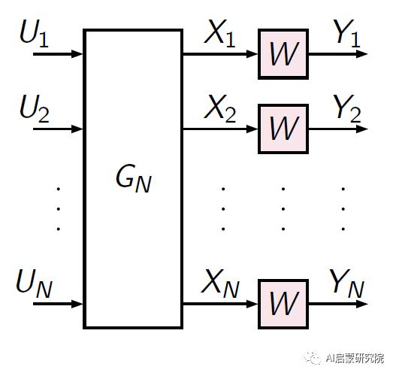
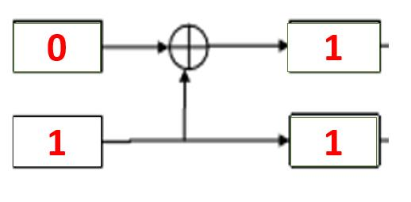
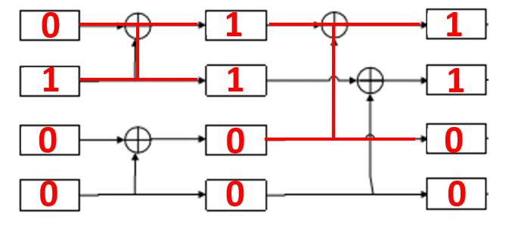
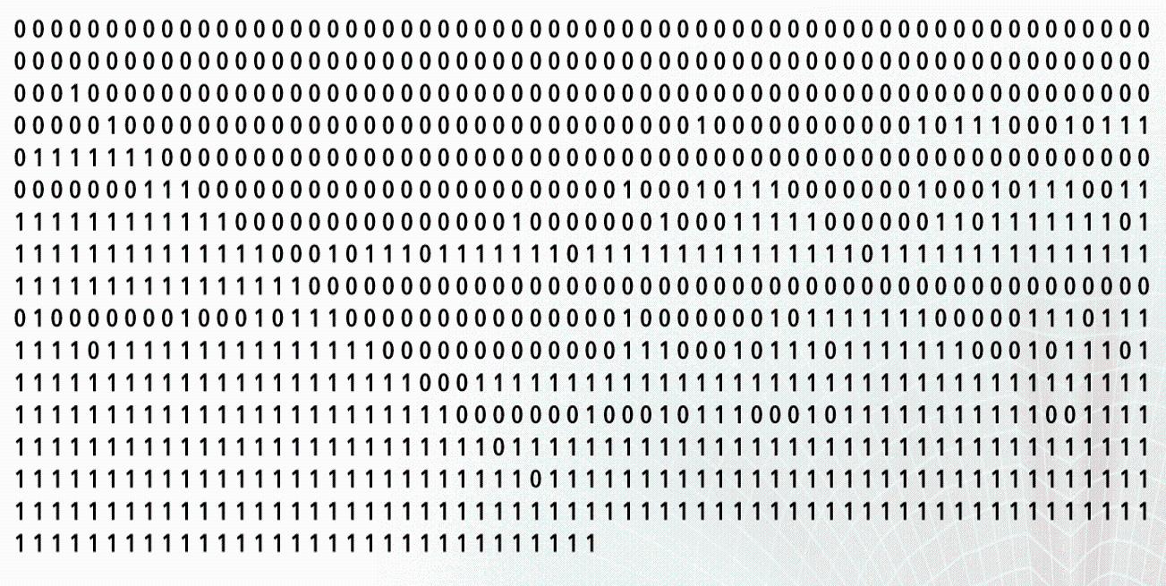
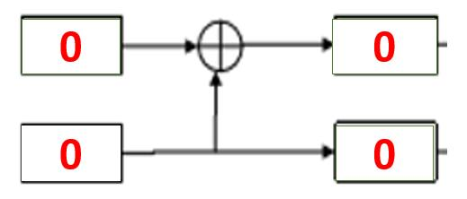
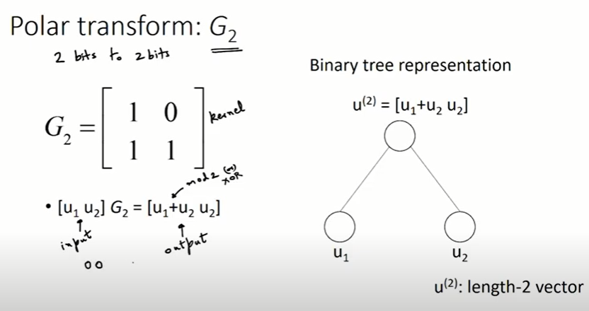
Polarization Transformation Encoder

Slide 5
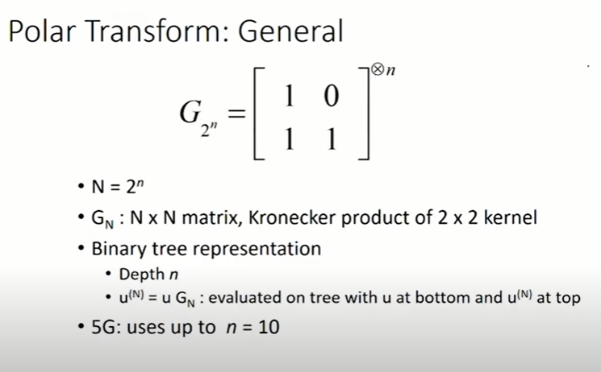
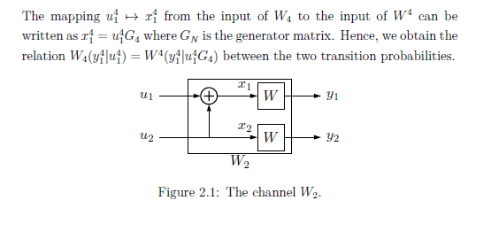
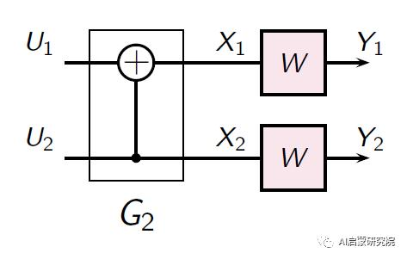
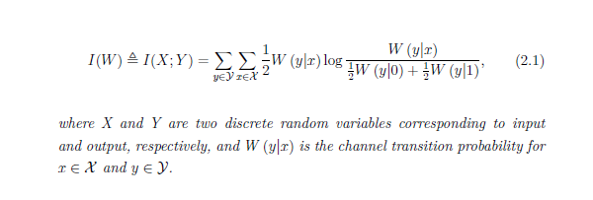

Slide 6
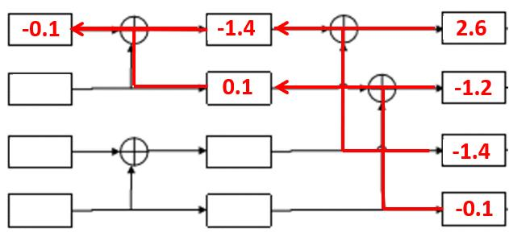
Successive Cancellation (SC) Decoder

Slide 7
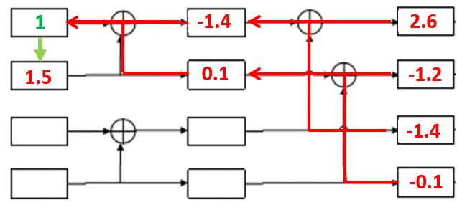
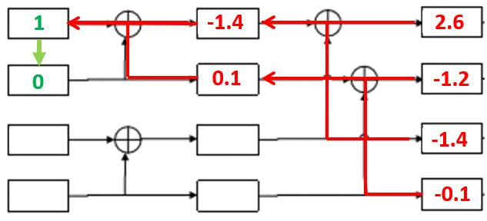
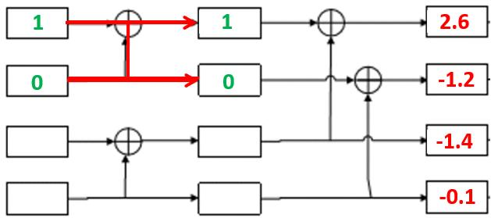
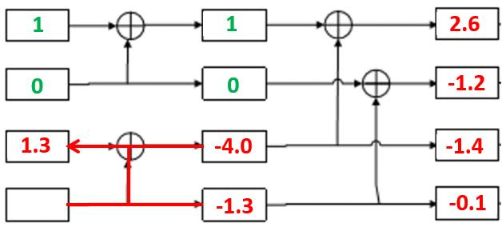
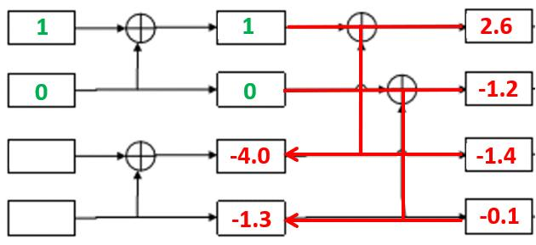
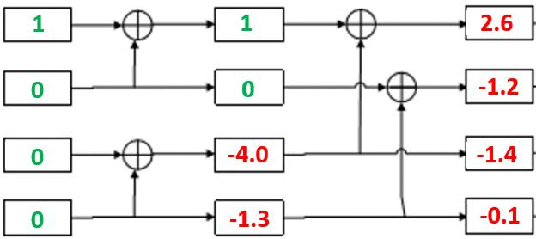
Successive Cancellation (SC) Decoder

Slide 8
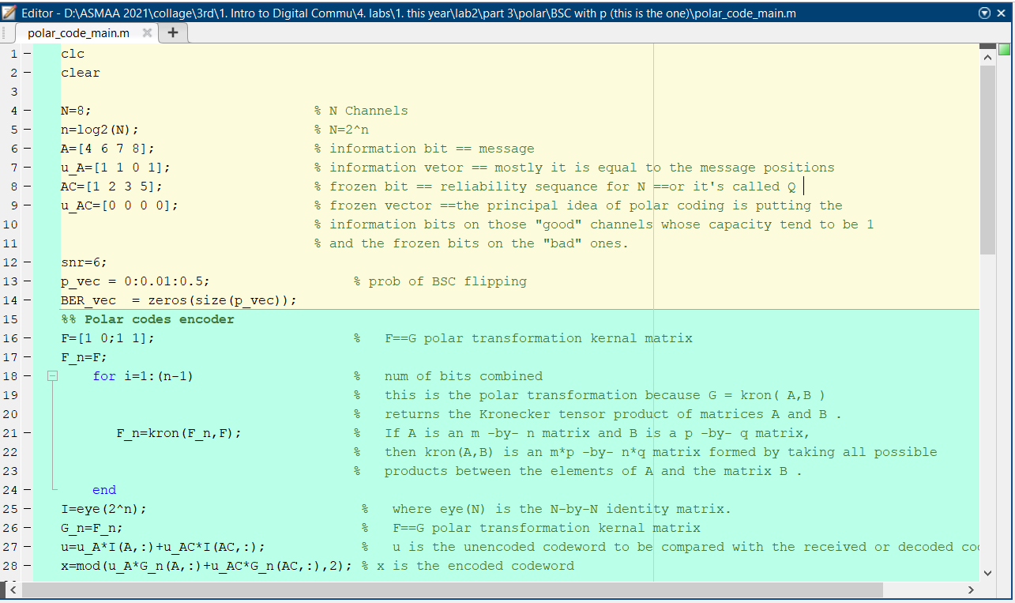
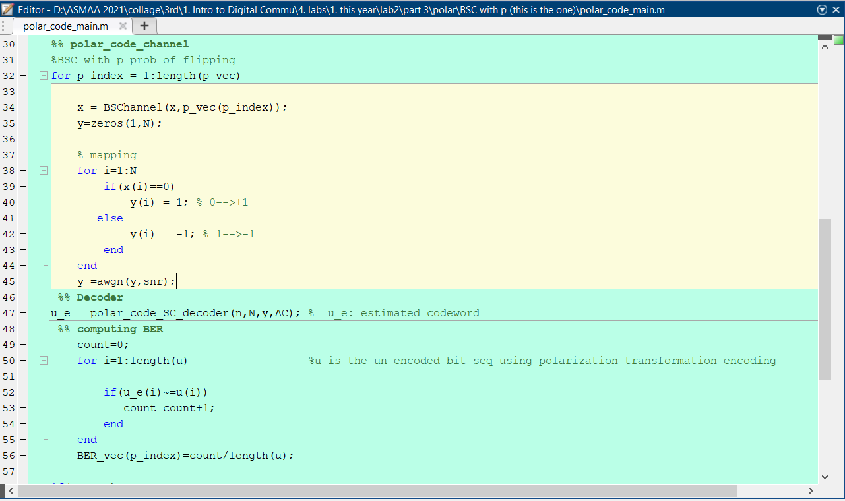
The MATLAB implementation Code

Slide 9
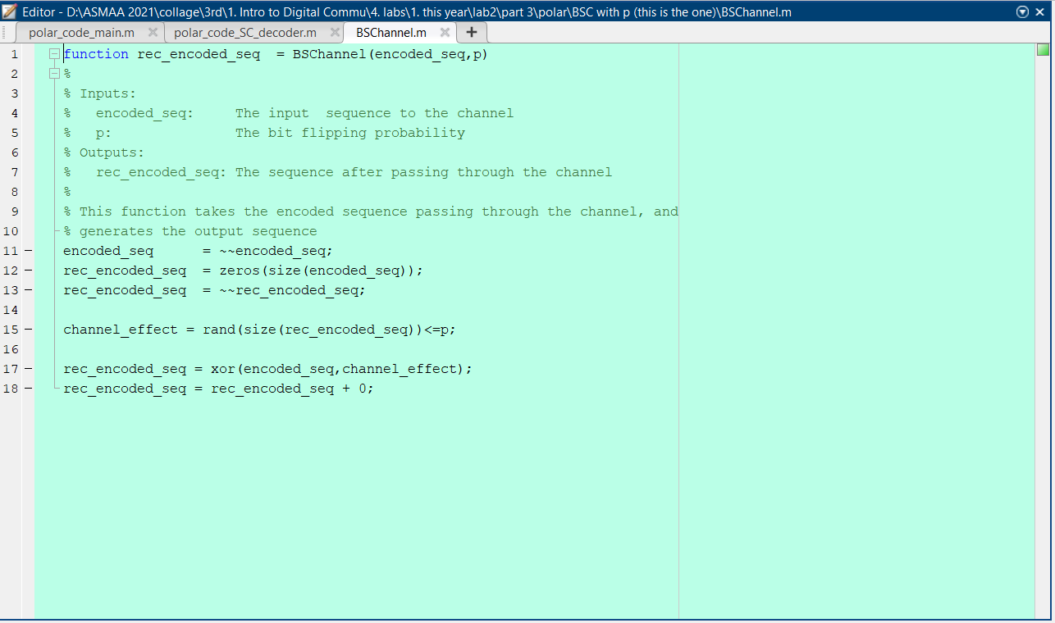
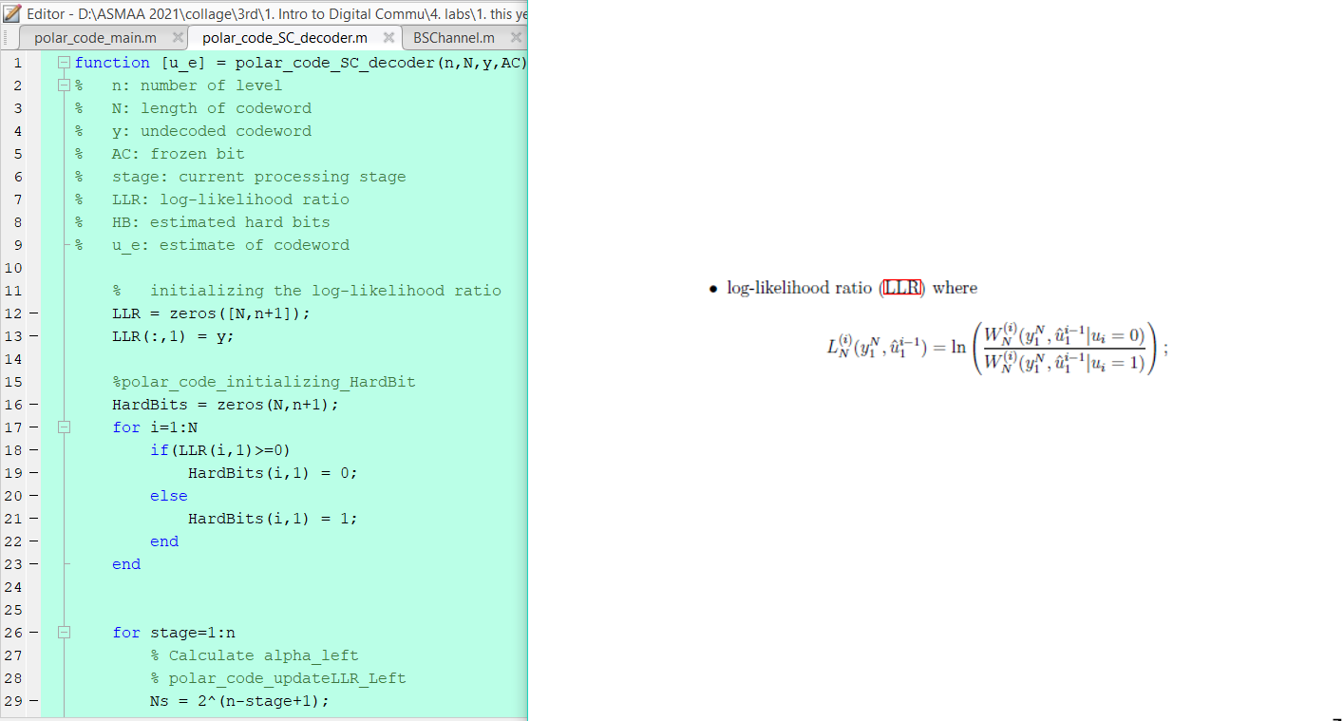
The MATLAB implementation Code

Slide 10
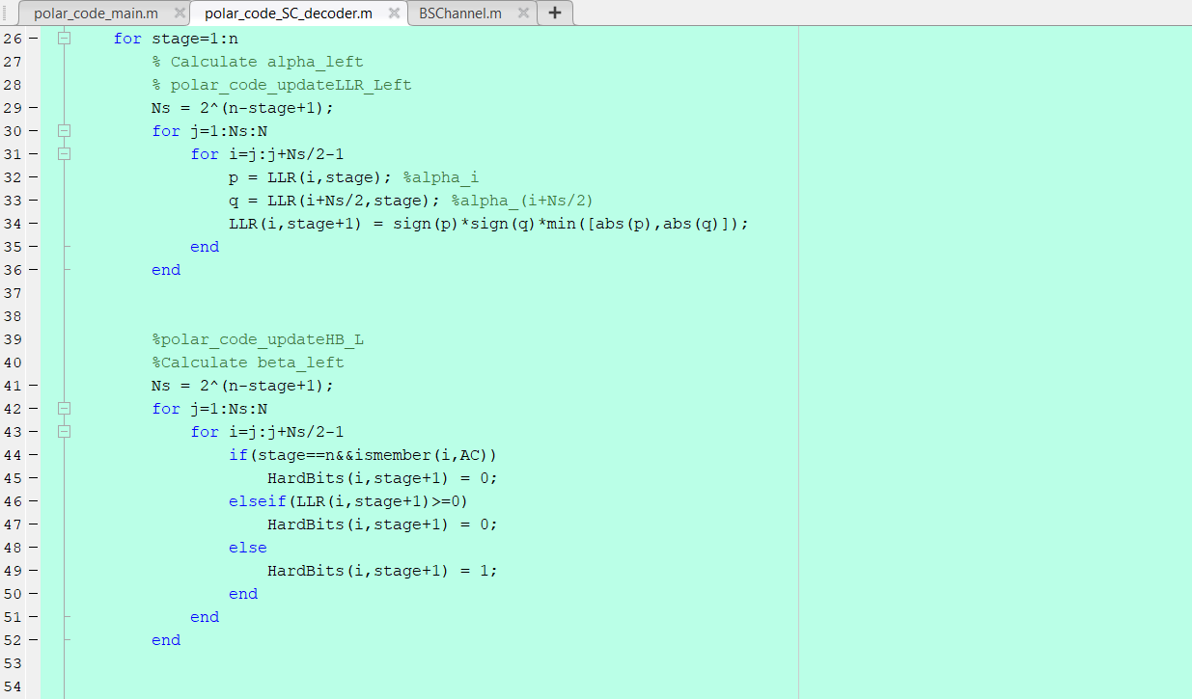
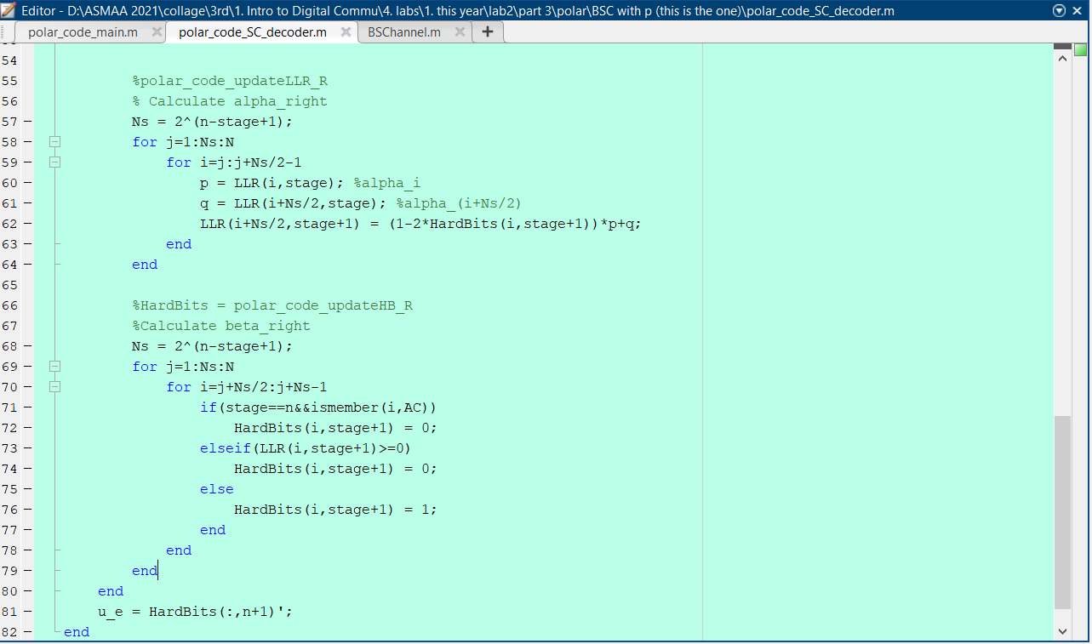
The MATLAB implementation Code

Slide 11
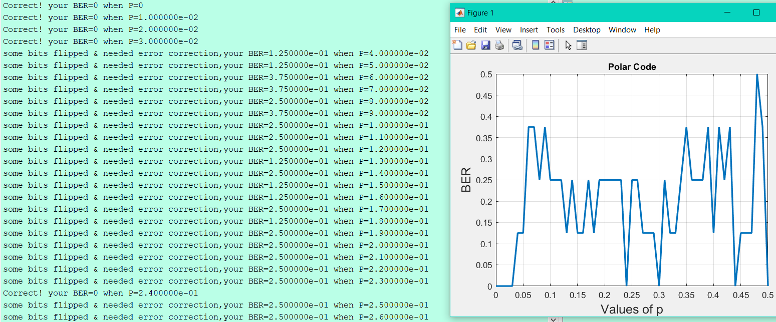
Results

Slide 12
References
Book:
POLAR CODES FOR ERROR CORRECTION, ANALYSIS AND DECODING ALGORITHMS.
2. Videos and Links:
https://youtu.be/D_gadv-V-MQ
https://youtu.be/Vj-1PwUNBek
https://www.youtube.com/watch?v=S3bZOSlNFGo
https://youtu.be/PNBFUV-ZetY
https://github.com/cihatkececi/ChannelCodingProjectList#polar-codes

Slide 13


The End.. Thanks to Allah !
Any Questions?
Asmaa Gamal Abdel Halem Mabrouk Nagy
Communications & Electronics
15010473

